Slide 1
Understanding Police Stops: Patterns and Predictions
By: Jahaira, Mariah, and Abe

Slide 2
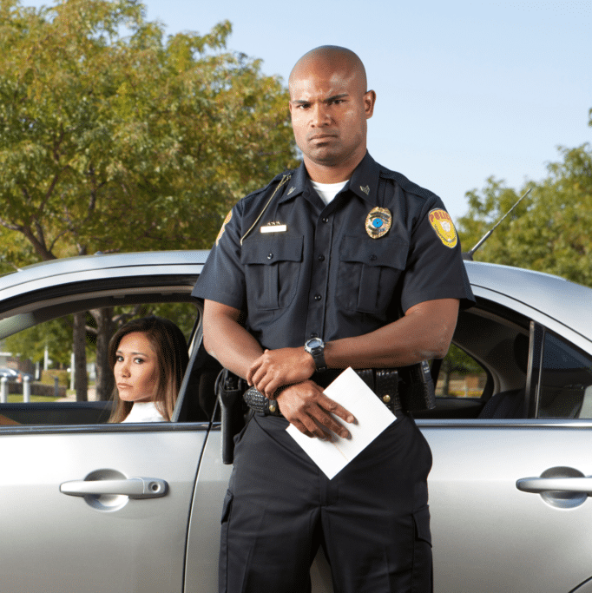
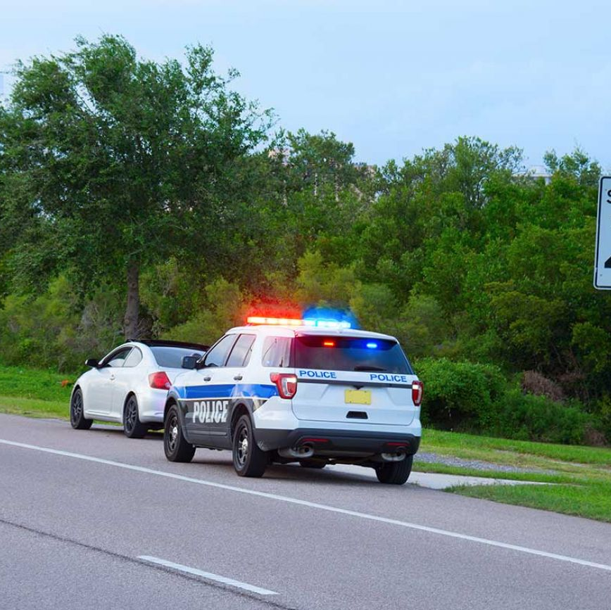
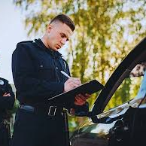
Business Problem
What are the most common reasons for police stops?
Can we predict traffic stops based on race, gender, and actions taken?
How can the general public avoid unnecessary stops?

Slide 3
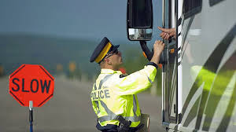
Intended Audience
General Public
Policy Makers
Law Enforcement Analysts

Slide 4
Data Source
Stanford Open Policing Project (Kaggle)
San Francisco Police Stop Data (SFGov API)
Key Features:
Race and Gender of Individuals Stopped
Reason for Stop
Actions Taken (e.g., warning, search, arrest)
Stop Outcomes

Slide 5
Methods
Data Cleaning & Preprocessing
Exploratory Data Analysis (EDA)
Machine Learning Model

Slide 6
